Slide 1

Building
Cloud-driven Solutions with Azure Event Grid
Notes:
Script
What are you going to tell us? - Show Agenda
That's interesting please share us your story (let's dig in)
You mention EDA and events - however these concepts are not new? Can you explain?
What does Microsoft offer? Dive into Event Grid
Do have an example? Show solution
What other types of scenario's?
Can you show us?
Is Microsoft the only one?
Any takeaways?
Thanks - Q&A

Slide 2

Agenda
Story on event-driven cloud solutions
Event driven architecture (EDA)
Azure Event Grid
Event driven solutions in Azure
Use cases
Demo
Azure competitors
Takeaways
Big photo covering the side

Slide 3
Event-driven Architecture
Near real-time
Loose coupling (decoupling)
Plug-and-play
Data exchange based on events

Slide 4
Events
Temperature change
State of an object
Change in Azure subscription

Slide 5
Are events something new? Or is EDA new?
A software architecture paradigm promoting the production, detection, consumption of, and reaction to events.
Event Producer doesn’t know its consumers
Event stream processing
Consumers react on events
Complex event processing
Event Channel aka Event Bus
Notes:
https://www.computable.nl/artikel/opinie/ict-branche/1821711/1509029/event-driven-architecture-een-andere-manier-van-denken.html
Event Producer is unaware of who will consume the events it produces (emits)
Consumer react upon events
Event Channel a mechanism of propagating the information collected from an event generator to the event engine or sink. Protocol and format
Complex event processing (CEP) allows patterns of simple and ordinary events to be considered to infer that a complex event has occurred. Complex event processing evaluates a confluence of events and then acts. The events (notable or ordinary) may cross event types and occur over a long period of time. The event correlation may be causal, temporal, or spatial. CEP requires the employment of sophisticated event interpreters, event pattern definition and matching, and correlation techniques. CEP is commonly used to detect and respond to business anomalies, threats, and opportunities.
In event stream processing (ESP), both ordinary and notable events happen. Ordinary events (orders, RFID transmissions) are screened for notability and streamed to information subscribers. Event stream processing is commonly used to drive the real-time flow of information in and around the enterprise, which enables in-time decision making.

Slide 6
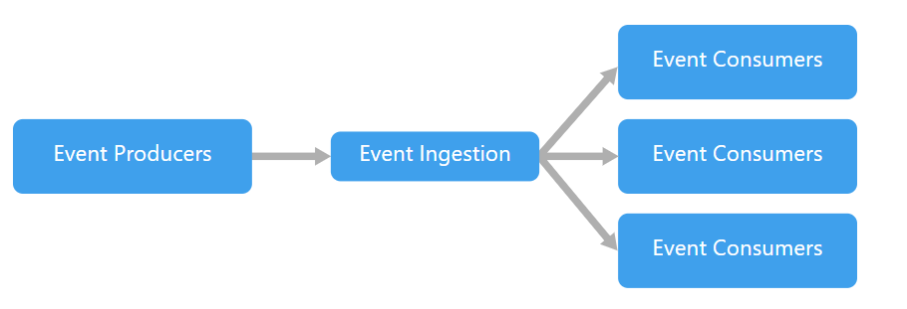
Event-driven architecture style
When to use this architecture:
Multiple subsystems must process the same events.
Real-time processing with minimum time lag.
Complex event processing, such as pattern matching or aggregation over time windows.
High volume and high velocity of data, such as IoT.
Notes:
https://docs.microsoft.com/en-us/azure/architecture/guide/architecture-styles/event-driven

Slide 7

Azure Event Grid

Slide 8
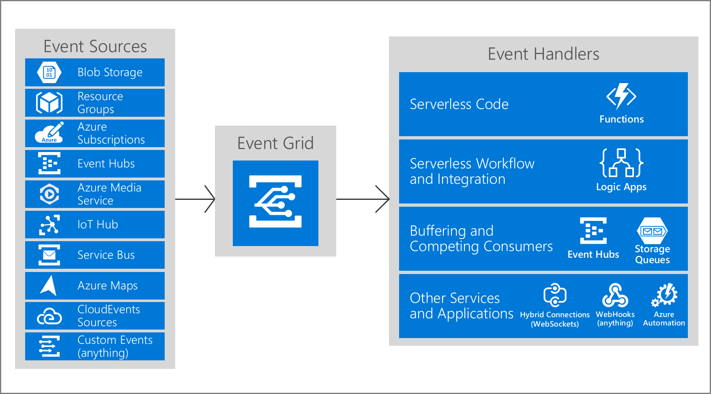
Azure Event Grid

Slide 9
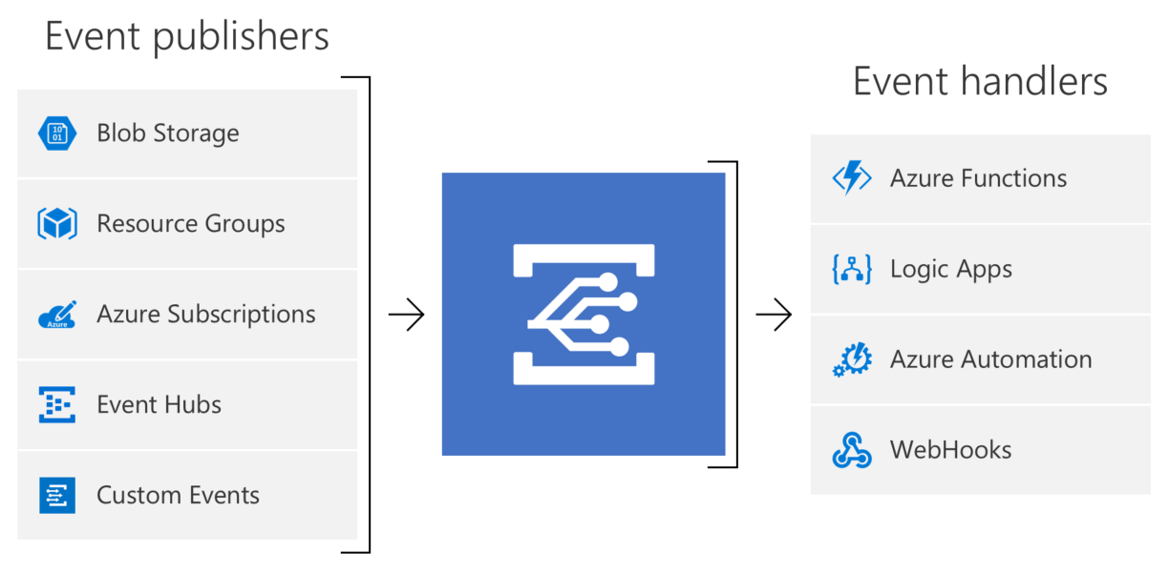
Concepts
Events: what happened
Event Publishers: where it took place
Topics: where publishers send events
Event Subscriptions: how you receive events
Event Handlers: the app or service reacting to the event

Slide 10
Event Grid Schema
Proprietary - Azure
CNCF - CloudEvent
[
{
"topic": string,
"subject": string,
"id": string,
"eventType": string,
"eventTime": string,
"data":{
object-unique-to-each-publisher
},
"dataVersion": string,
"metadataVersion": string
}
]
[
{
"specversion": string,
"type": string,
"source": string,
"id": string,
"time": string,
"subject": string,
"dataschema": string
"data":{
object-unique-to-each-publisher
},
}
]

Slide 11
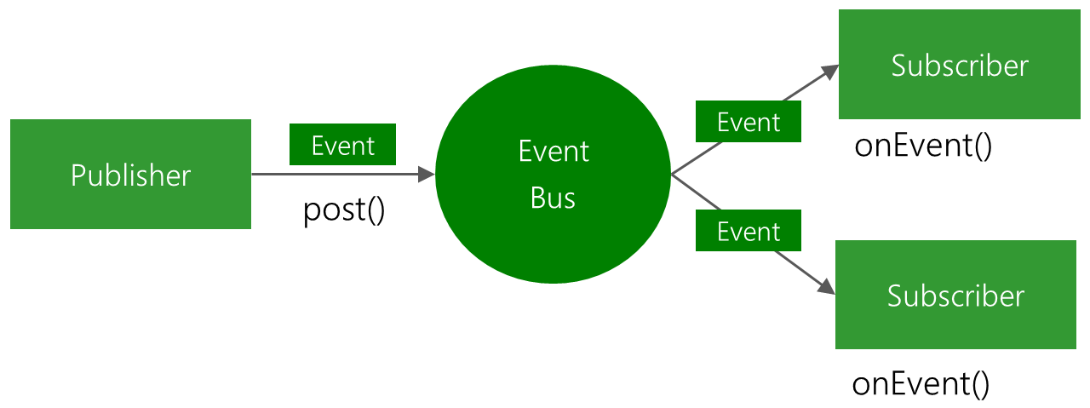
Routing of events
The key capability of Event Grid is intelligent routing of events
Routing of events through filtering of:
Subject
Type
Data

Slide 12
Filter options
Type
All
Supported Proprietary Event Type e.g., Microsoft.Resources.ResourceWriteSuccess
Custom Type
Subject
Prefix (starts with)
Postfix (ends with)
Advanced
Data property (operator, key/value)
Notes:
Event Type: By default, all event types for the event source are sent to the endpoint. You can decide to send only certain event types to your endpoint. For example, you can get notified of updates to your resources, but not notified for other operations like deletions. In that case, filter by the Microsoft.Resources.ResourceWriteSuccess event type. Provide an array with the event types or specify All to get all event types for the event source.
Subject: For simple filtering by subject, specify a starting or ending value for the subject. For example, you can specify the subject ends with .txt to only get events related to uploading a text file to storage account. Or, you can filter the subject begins with /blobServices/default/containers/testcontainer to get all events for that container but not other containers in the storage account.
Advanced filtering: To filter by values in the data fields and specify the comparison operator, use the advanced filtering option. In advanced filtering, you specify the:
operator type - The type of comparison.
key - The field in the event data that you're using for filtering. It can be a number, boolean, or string.
values - The value or values to compare to the key.

Slide 13
Event-driven solution

Slide 14
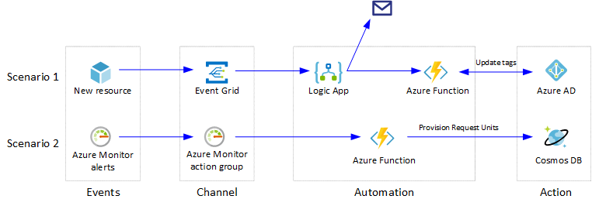
Event Grid Scenario – Automation
Notes:
https://docs.microsoft.com/en-us/azure/architecture/reference-architectures/serverless/cloud-automation

Slide 15
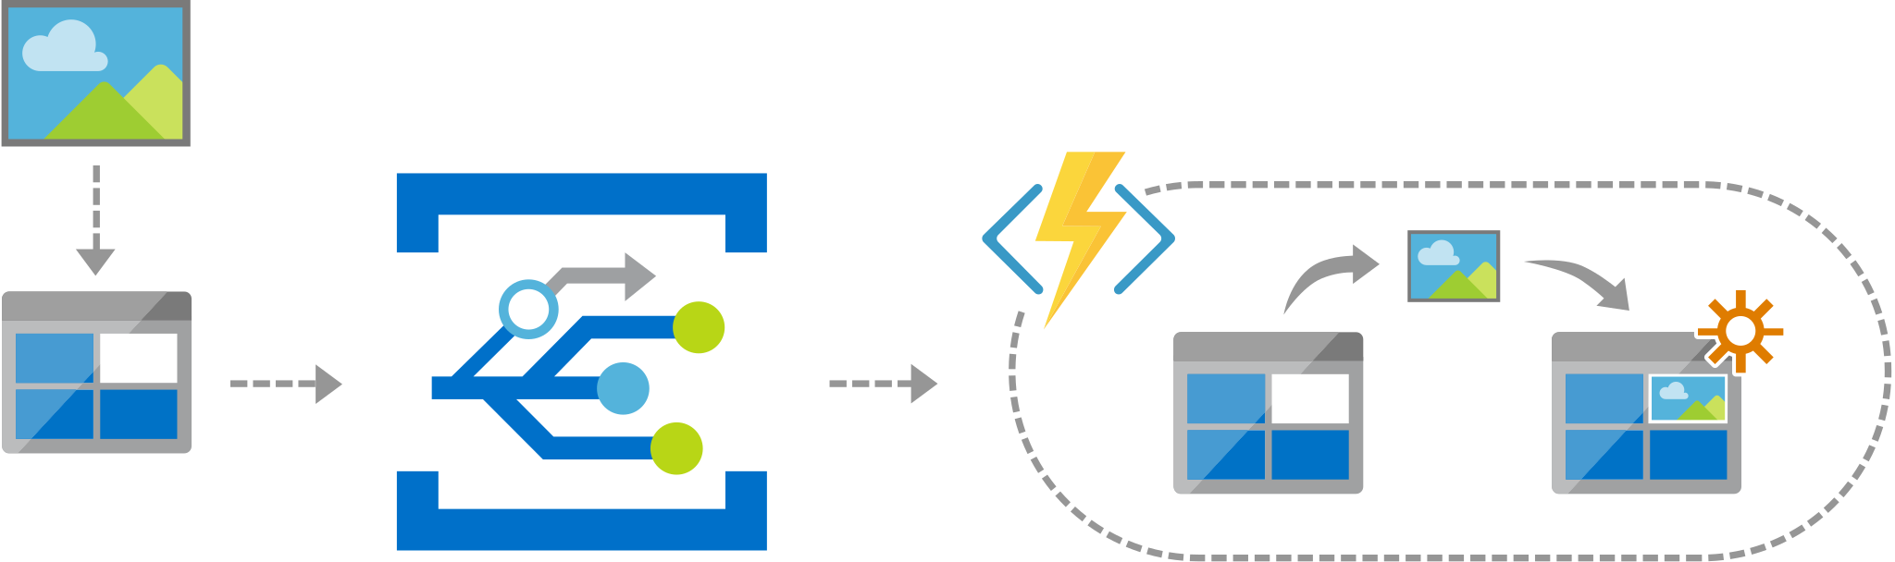
Event Grid Scenario – Serverless Apps
Notes:
https://docs.microsoft.com/en-us/azure/architecture/solution-ideas/articles/serverless-application-architectures-using-event-grid

Slide 16
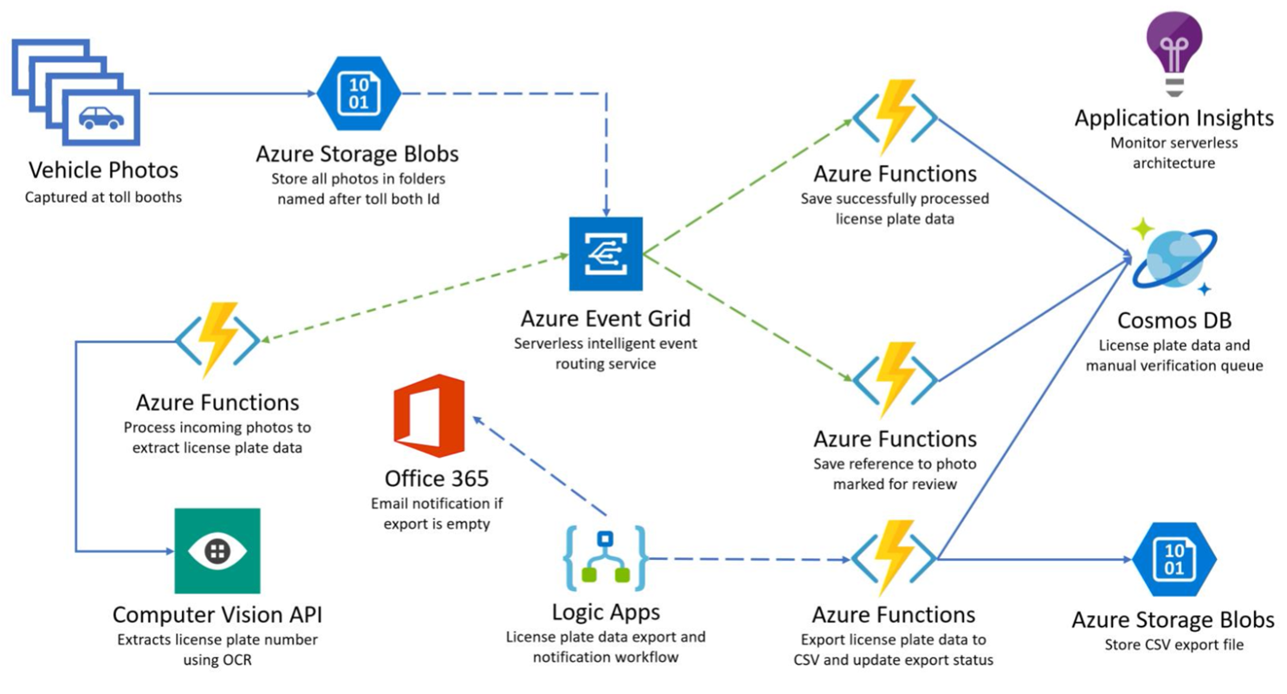
Serverless Event-driven solution

Slide 17
DEMO
Notes:
Show Azure Event Grid Including Event Grid Viewer (messages)
Show Events in Storage (metrics, and filters)
Show Functions

Slide 18
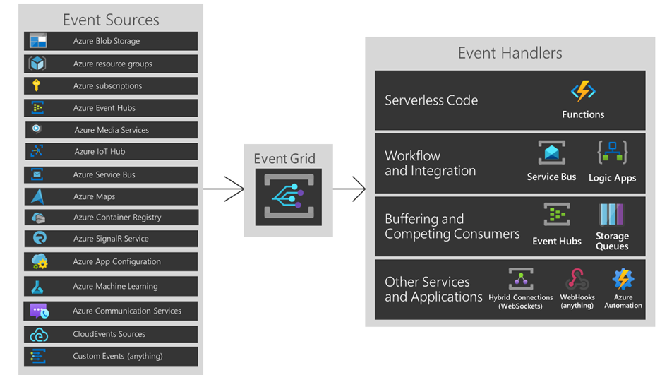
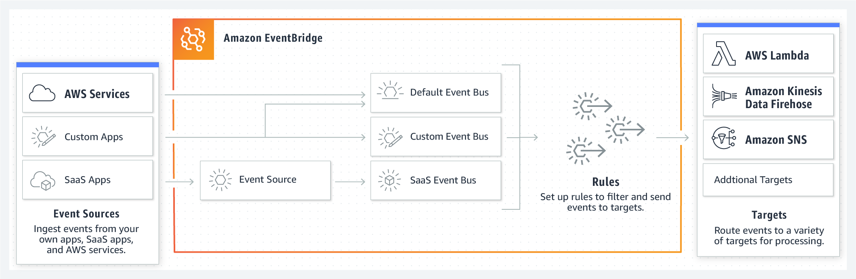
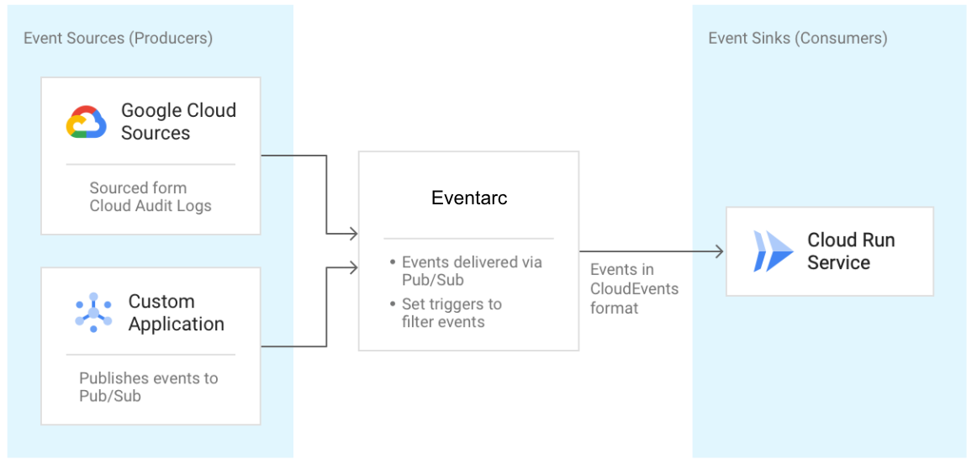
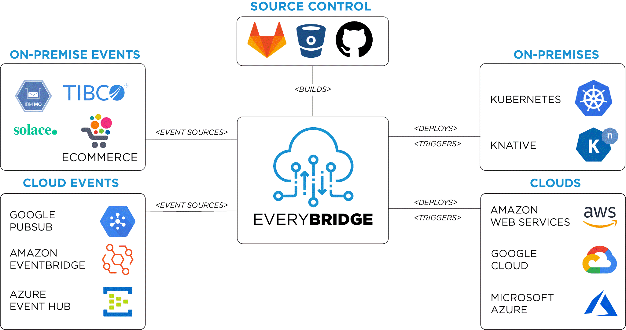
Azure Event Grid Competitors
Microsoft - Azure Event Grid
AWS – Amazon EventBridge
GCP – Eventarc
Other - EveryBridge

Slide 19

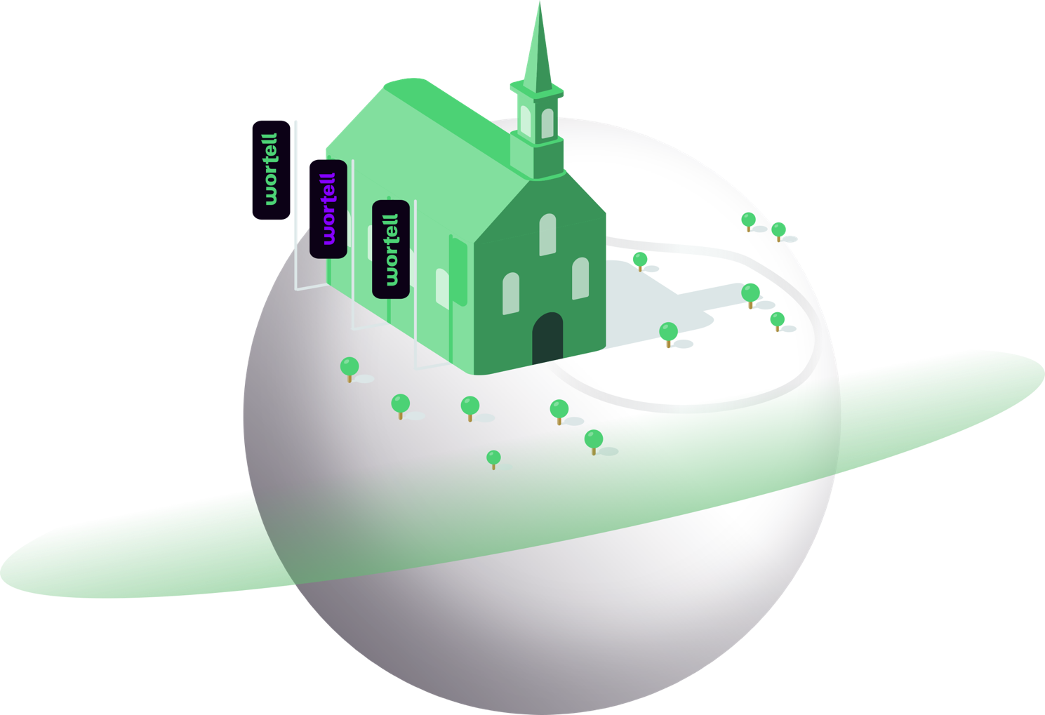


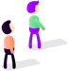
Takeaways
4.
Modern architecture on top off proven principles
3.
Proven technology
2.
A mature service for event-driven solutions
1.
Low barrier of entry

Slide 20
Resources
Architecture Center
Serverless Notes
InfoQ
Microsoft Docs
Azure Event Grid
Medium Blog

Slide 21
Q&A

